Slide 1
ITCS 3134 YinHang Kwok
E18 - Representation

Slide 2
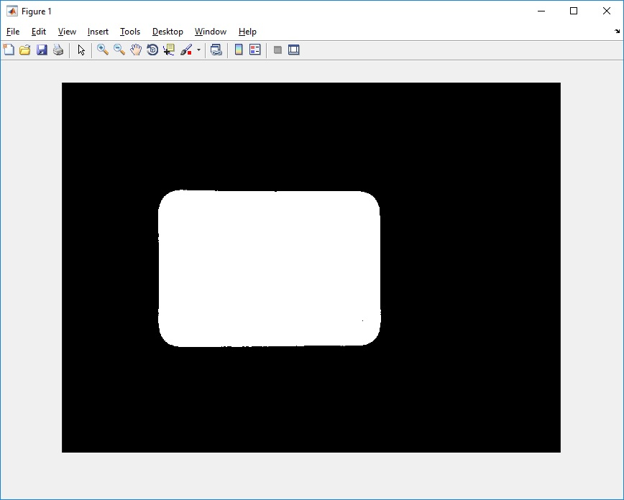
Binary image with the largest region only (after closing)
Key.1.jpg

Slide 3
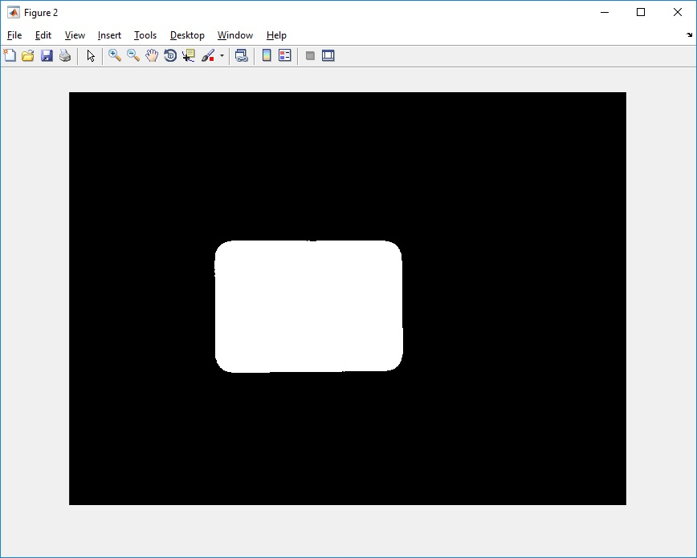
Binary image with the largest region only (after closing)
Key.2.jpg

Slide 4
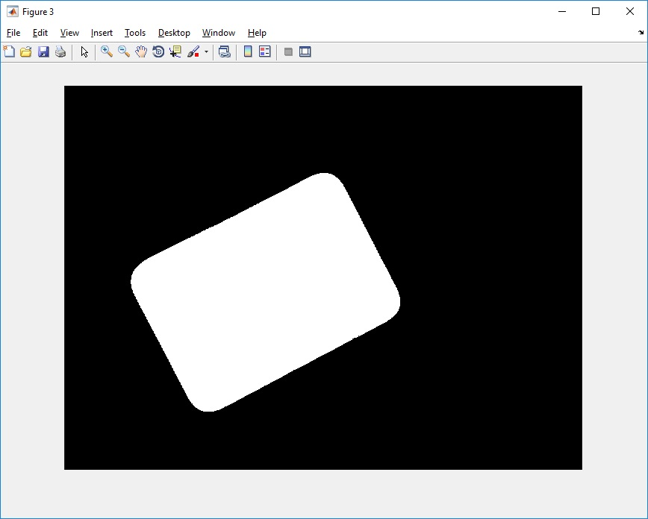
Binary image with the largest region only (after closing)
Key.3.jpg

Slide 5
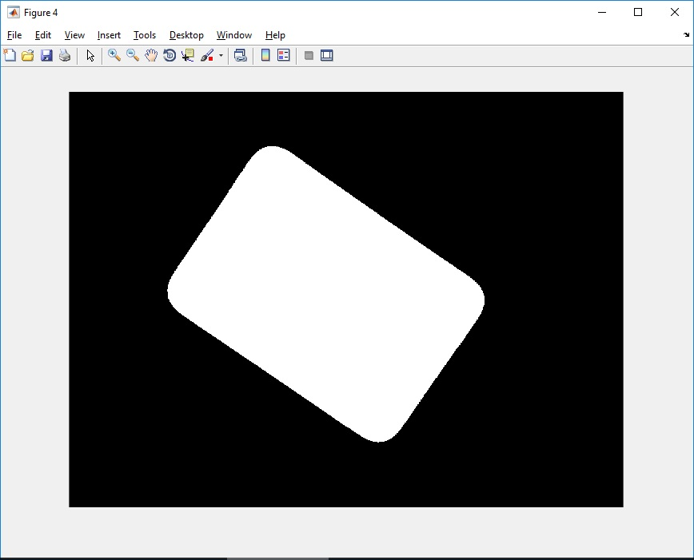
Binary image with the largest region only (after closing)
Key.4.jpg

Slide 6
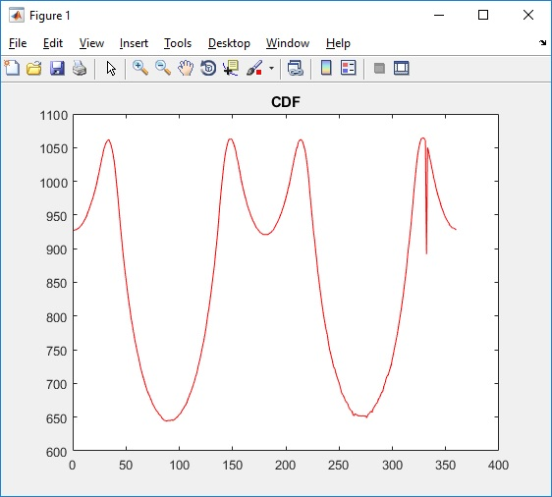
Centroid distance function without scale normalization.
Key.1.jpg

Slide 7
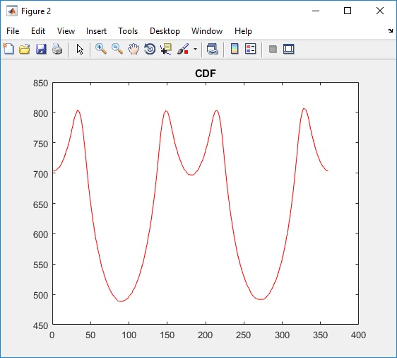
Centroid distance function without scale normalization.
Key.2.jpg

Slide 8
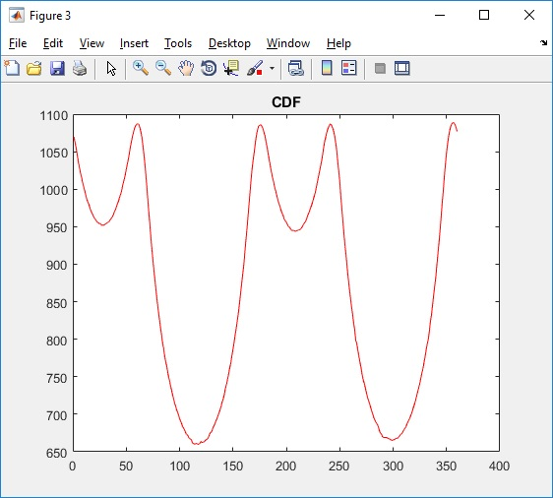
Centroid distance function without scale normalization.
Key.3.jpg

Slide 9
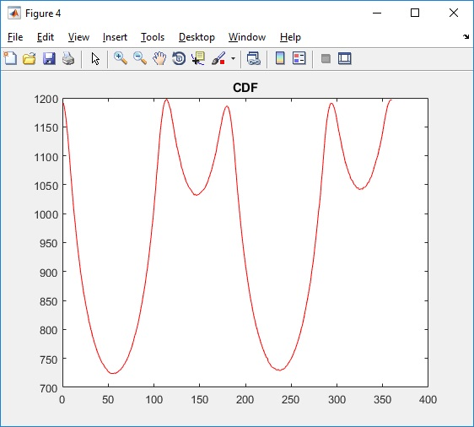
Centroid distance function without scale normalization.
Key.4.jpg

Slide 10
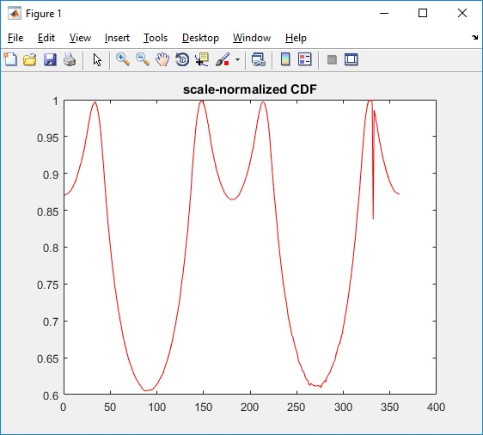
Centroid distance function with scale normalization.
Key.1.jpg

Slide 11
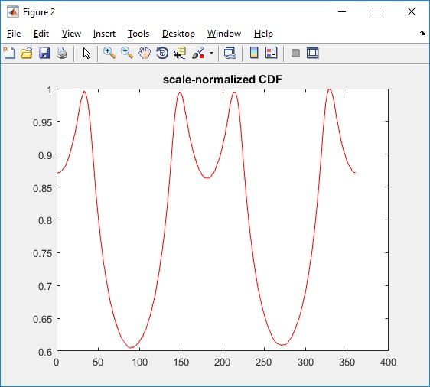
Centroid distance function with scale normalization.
Key.2.jpg

Slide 12
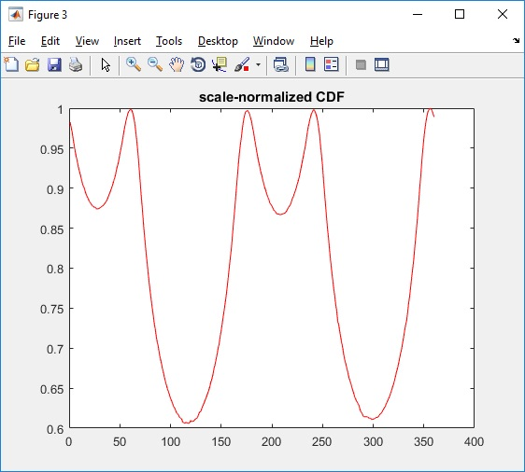
Centroid distance function with scale normalization.
Key.3.jpg

Slide 13
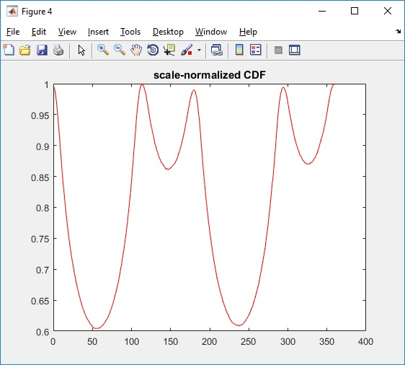
Centroid distance function with scale normalization.
Key.4.jpg

Slide 14
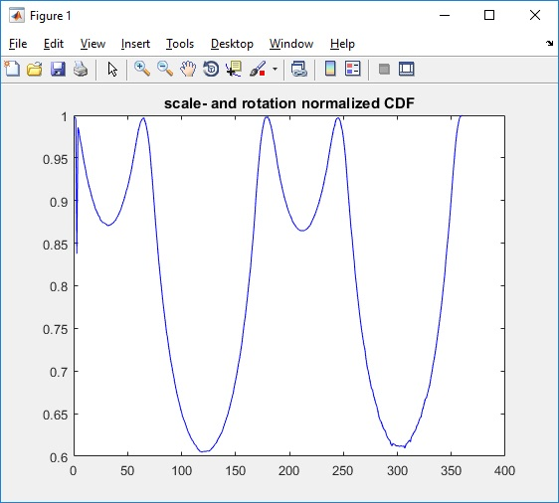
Centroid distance function with rotation normalization
Key.1.jpg

Slide 15
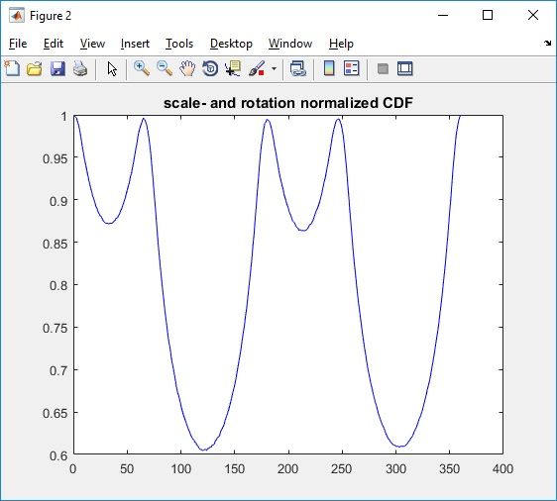
Centroid distance function with rotation normalization
Key.2.jpg

Slide 16
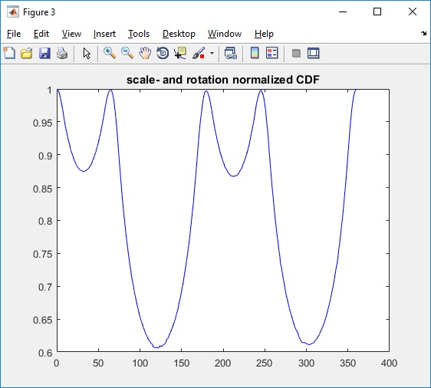
Centroid distance function with rotation normalization
Key.3.jpg

Slide 17
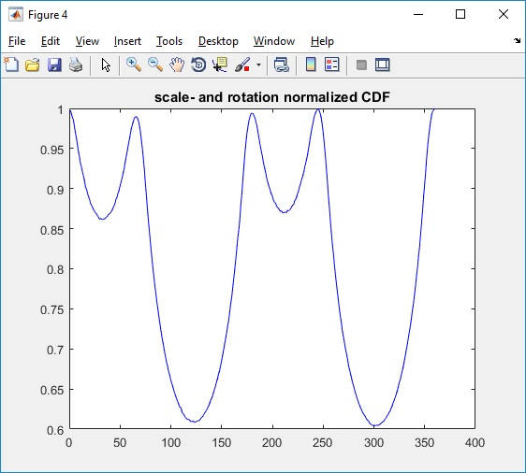
Centroid distance function with rotation normalization
Key.4.jpg

